Slide 1
Future directions in computer science research
John Hopcroft
Department of Computer Science
Cornell University

Slide 2
Time of change
The information age is a revolution that is changing all aspects of our lives.
Those individuals, institutions, and nations who recognize this change and position themselves for the future will benefit enormously.

Slide 3
Computer Science is changing
Early years
  Programming languages
  Compilers
  Operating systems
  Algorithms
  Data bases
  Emphasis on making computers useful

Slide 4
Computer Science is changing
The future years
  Tracking the flow of ideas in scientific literature
  Tracking evolution of communities in social networks
  Extracting information from unstructured data
  sources
  Processing massive data sets and streams
  Extracting signals from noise
  Dealing with high dimensional data and dimension
  reduction
  The field will become much more application oriented

Slide 5
Computer Science is changing
Drivers of change
Merging of computing and communication
The wealth of data available in digital form
Networked devices and sensors

Slide 6
Implications for
Theoretical Computer Science
Need to develop theory to support the new directions
Update computer science education

Slide 7
Theory to support new directions
Large graphs
Spectral analysis
High dimensions and dimension reduction
Clustering
Collaborative filtering
Extracting signal from noise
Sparse vectors
Learning theory

Slide 8
Outline of talk
A short view of the future
Examples of a science base
    Large graphs
    High dimensional space

Slide 9
Sparse vectors
There are a number of situations where sparse vectors are important.
  Tracking the flow of ideas in scientific literature
  Biological applications
  Signal processing

Slide 10
Sparse vectors in biology
plants
Phenotype
Observables
Outward manifestation
Genotype
Internal code

Slide 11
Digitization of medical records
Doctor – needs my entire medical record
Insurance company – needs my last doctor
visit, not my entire medical record
Researcher – needs statistical information but
no identifiable individual information
Relevant research – zero knowledge proofs, differential privacy

Slide 12
A zero knowledge proof of a statement is a proof that the statement is true without providing you any other information.

Slide 13
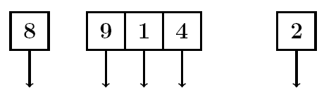
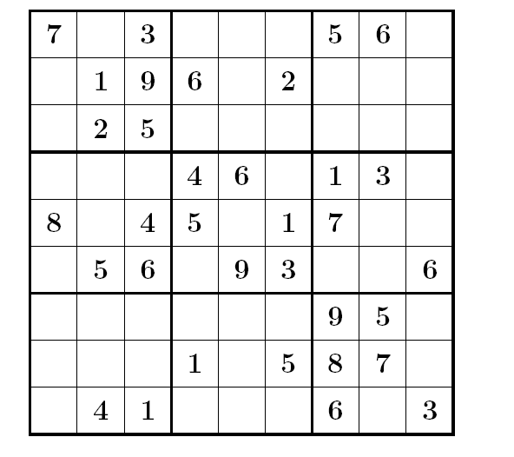

Slide 14
Zero knowledge proof
Graph 3-colorability
Problem is NP-hard - No polynomial time algorithm unless P=NP

Slide 15
Zero knowledge proof

Slide 16
Digitization of medical records is not the only system
Car and road – gps – privacy
Supply chains
Transportation systems

Slide 17
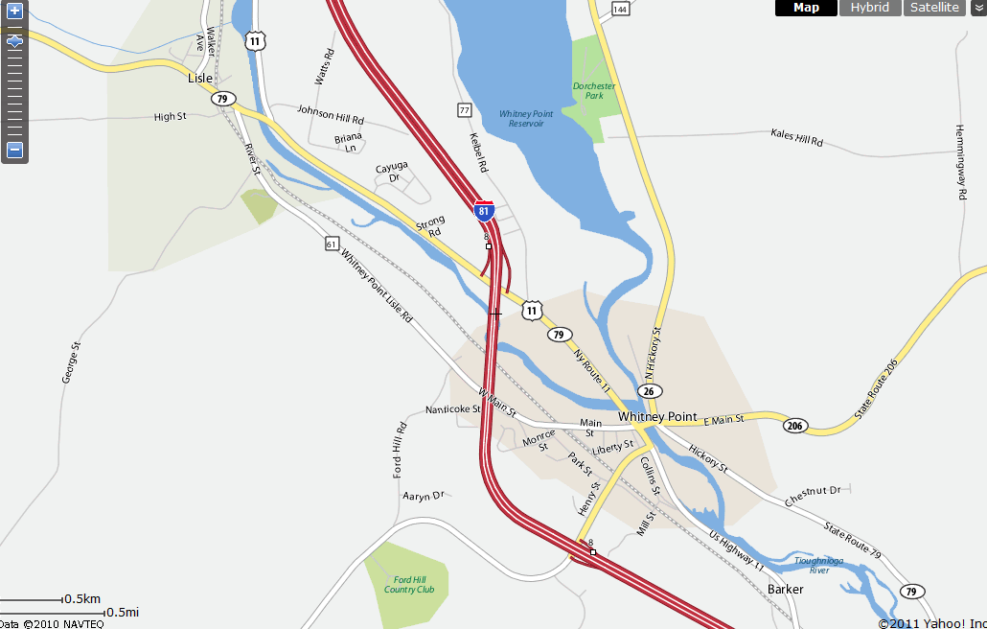

Slide 18
In the past, sociologists could study groups of a few thousand individuals.
Today, with social networks, we can study interaction among hundreds of millions of individuals.
One important activity is how communities form and evolve.

Slide 19
Future work
  Consider communities with more external edges than internal edges
  Find small communities
  Track communities over time
  Develop appropriate definitions for communities
  Understand the structure of different types of social networks

Slide 20
Our view of a community
Colleagues at Cornell
Classmates
TCS
Me
More connections outside than inside
Family and friends

Slide 21
What types of communities are there?
How do communities evolve over time?
Are all social networks similar?

Slide 22
Are the underlying graphs for social networks similar or do we need different algorithms for different types of networks?
G(1000,1/2) and G(1000,1/4) are similar, one is just denser than the other.
G(2000,1/2) and G(1000,1/2) are similar, one is just larger than the other.

Slide 23
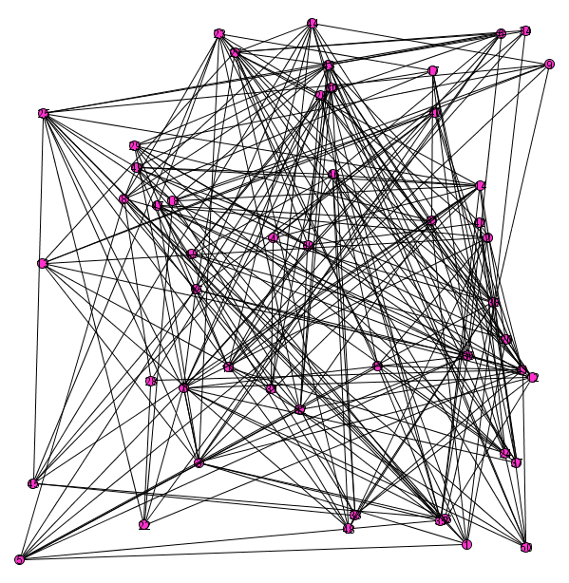
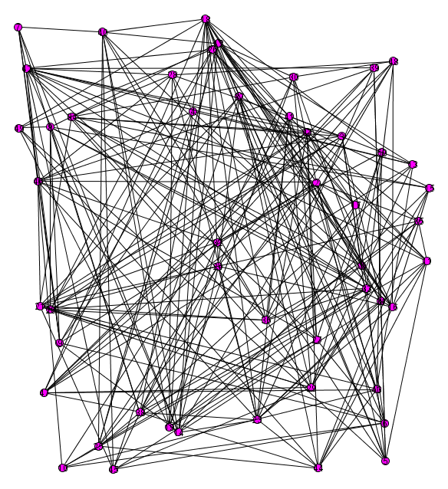

Slide 24
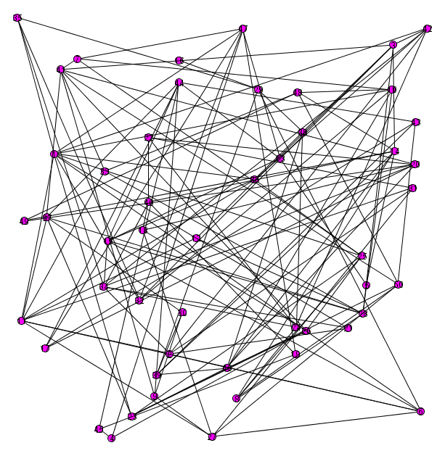
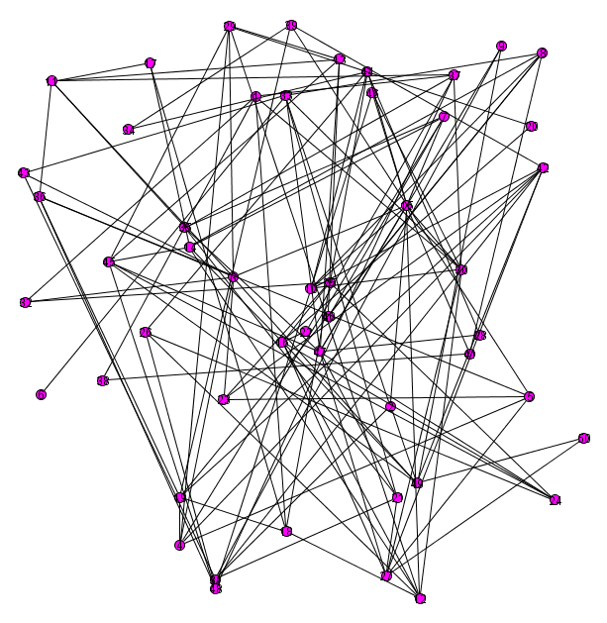

Slide 25
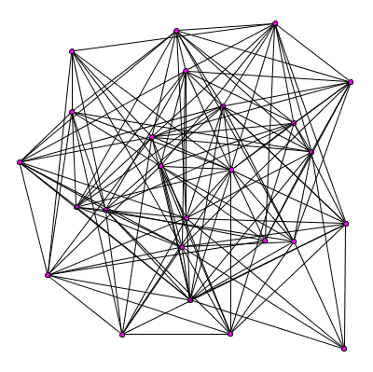

Slide 26
Two G(n,p) graphs are similar even though they have only 50% of edges in common.
What do we mean mathematically when we say two graphs are similar?

Slide 27
Physics
Chemistry
Mathematics
Biology

Slide 28
Survey
Expository
Research

Slide 29
English Speaking Authors
Asian Authors
English Second Language
Others

Slide 30
Established Authors
Young Authors

Slide 31
Discovering hidden structures in social networks

Slide 32
One structure with random noise
One structure
Add random noise
After randomly permute

Slide 33
Two structures in a graph
Dominant structure Randomly permute Add hidden structure Randomly permute

Slide 34
Another type of hidden structure
Permuted by
dominant structure
Permuted by
hidden structure
Randomly permuted

Slide 35
Science Base
What do we mean by science base?
  Large Graphs
  High dimensional space

Slide 36
Theory of Large Graphs
Large graphs with billions of vertices
Exact edges present not critical
Invariant to small changes in definition
Must be able to prove basic theorems

Slide 37
Erdös-Renyi
n vertices
each of n² potential edges is present with independent probability
N
n
p^{n} (1-p)^{N-n}
number
of
vertices
vertex degree
binomial degree distribution

Slide 38
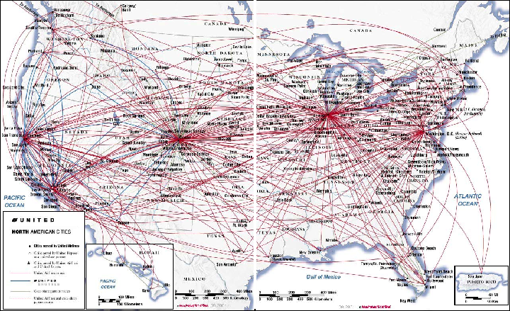

Slide 39
Generative models for graphs
Vertices and edges added at each unit of
time
Rule to determine where to place edges
  Uniform probability
  Preferential attachment - gives rise to power law degree distributions

Slide 40
Preferential attachment gives rise to the power law degree distribution common in many graphs.
Number
of
vertices
Vertex degree

Slide 41
Protein interactions
2730 proteins in data base
3602 interactions between proteins
Only 899 proteins in components. Where are the 1851 missing proteins?
Science 1999 July 30; 285:751-753

Slide 42
Protein interactions
2730 proteins in data base
3602 interactions between proteins
Science 1999 July 30; 285:751-753

Slide 43
Science Base for High Dimensional Space

Slide 44
High dimension is fundamentally different from 2 or 3 dimensional space

Slide 45
High dimensional data is inherently unstable.
Given n random points in d-dimensional space, essentially all n² distances are equal.

Slide 46
High Dimensions
Intuition from two and three dimensions is not valid for high dimensions.
Volume of cube is one in all dimensions.
Volume of sphere goes to zero.

Slide 47
Gaussian distribution
Probability mass concentrated between dotted lines

Slide 48
Gaussian in high dimensions

Slide 49
Two Gaussians

Slide 52
Distance between two random points from same Gaussian
Points on thin annulus of radius
Approximate by a sphere of radius
Average distance between two points is
(Place one point at N. Pole, the other point at random. Almost
surely, the second point will be near the equator.)

Slide 55
Expected distance between points from two Gaussians separated by δ

Slide 56
Can separate points from two Gaussians if

Slide 57
Why is there a unique sparse solution?

Slide 58
If there were two s-sparse solutions x₁ and x₂ to Ax=b, then x=x₁-x₂ is a 2s-sparse solution to Ax=0.
For there to be a 2s-sparse solution to the homogeneous equation Ax=0, a set of 2s columns of A must be linearly dependent.
Assume that the entries of A are zero mean, unit variance Gaussians.

Slide 59
Select first column in the set of linearly dependent columns
Set forms an orthonormal basis and hence
cannot be linearly dependent.

Slide 60
Dimension reduction
Project points onto subspace containing centers of Gaussians.
Reduce dimension from d to k, the number of Gaussians

Slide 61
Centers retain separation
Average distance between points reduced
by

Slide 62
Can separate Gaussians provided
> some constant involving k and γ independent of the dimension

Slide 63
We have just seen what a science base for high dimensional data might look like.
For what other areas do we need a science base?

Slide 64
Ranking is important
  Restaurants, movies, books, web pages
  Multi-billion dollar industry
Collaborative filtering
  When a customer buys a product, what else is he
  or she likely to buy?
Dimension reduction
Extracting information from large data sources
Social networks

Slide 65
This is an exciting time for computer science.
There is a wealth of data in digital format, information from sensors, and social networks to explore.
It is important to develop the science base to support these activities.

Slide 66
Remember that institutions, nations, and individuals who position themselves for the future will benefit immensely.
Thank You!

